Slide 1
Denning’s Information Flow Model (DFM)
DFM = (S,O, SC, ≤, ⊕) S
S is a set of subjects /principals (active agents responsible for all info. flow),
O is a set of objects (info. containers),
SC is a set of security classes ,
≤ is a binary relation on security classes that specifies permissible info. flows .
sc1≤ sc2 means: info. in security class sc1 is allowed/permitted to flow into security class sc2,
⊕ is the class-combining binary operator (assoc. & comm.) that specifies, for any pair of operand classes, the class in which the result of any binary function on values from the operand classes belongs

Slide 2

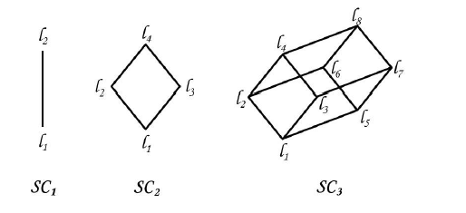
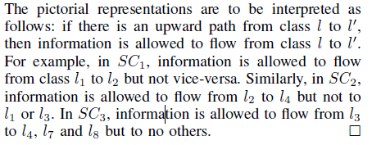

Slide 3
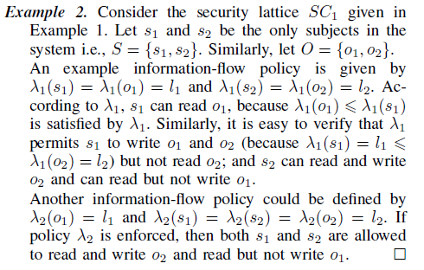

Slide 4
Security of Flows
A system enforcing Denning’s flow model DFM is secure if and only if execution of any sequence of operations of the system cannot give rise to a flow that violates the permissible information flow relation.
Further, the natural conditions required of information flow force the structure
(SC, ≤) to be a lattice with ⊕ as the least upper bound operator

Slide 5
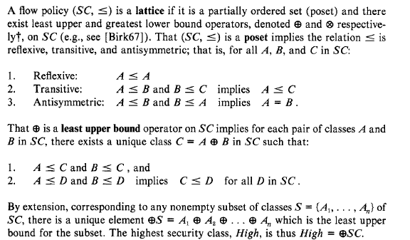
Flow Policy: Lattice Structure

Slide 6
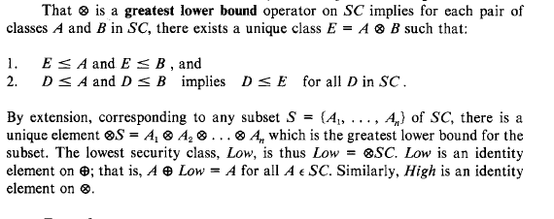

Slide 7
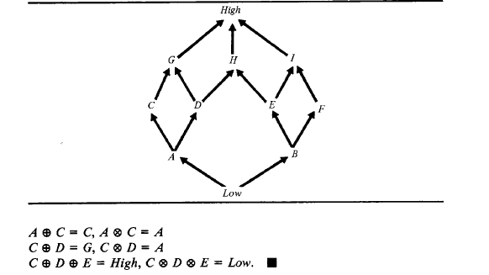

Slide 8
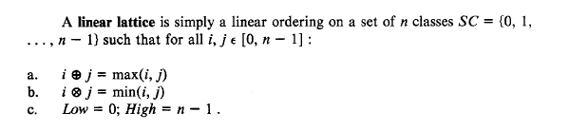

Slide 9
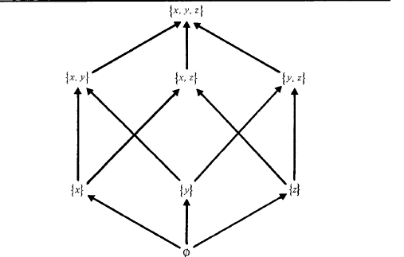
Subset lattice

Slide 10
Transformation of nonlattice policy into a lattice
Take an arbitrary flow policy P = (SC, ≤) and transform it into a lattice P' = (SC', ≤’);
classes A and B in SC have corresponding classes A' and B' in SC' such that A ≤ B in P if and only if A’ ≤’ B' in P‘
Flow is authorized under P if and only if it is authorized under P', where objects bound to class A in P are bound to class A' in P'.
Requires only that the relation ≤ be reflexive and transitive.
To derive a relation ≤’ that is also antisymmetric, classes forming cycles are compressed into single classes.
To provide least upper and greatest lower bound operators, new classes are added.

Slide 11
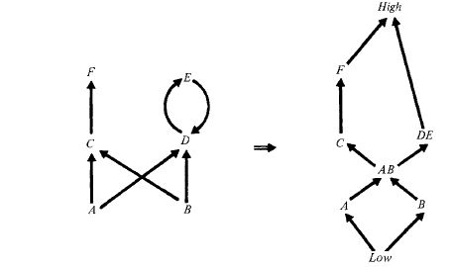
Example

Slide 12
Flow Properties
Transitivity of the relation ≤ implies any indirect flow
x→ y resulting from a sequence of flows
X = Z 0 → Z 1 . . . → Zn_ 1 → Zn = y
is permitted if each flow Zi_1 → Zi (1 ≤ i ≤ n) is permitted, because
x = z0 ≤ Z ≤ ... ≤ Zn-1 ≤ Zn = y implies x ≤ y (here reference is to security classes of the variables/objects)
Thus: an enforcement mechanism need only verify direct flows.

Slide 13
Examples
Example:
The security of the indirect flow x → y caused by executing the sequence of statements
z := x; y:=z
automatically follows from the security of the individual statements; that is,
x ≤ z and z ≤ y implies x ≤ y. (refers to security classes of x,y,z)
Example:
Consider the sequence (x =0 or 1 initially)
z := o;
if x= 1 then z:= 1; Indirect (xto z)
y:=z, Direct
z to y

Slide 14
Examples
To verify the security of an assignment statement:
y := x1 + x2 * x3
a compiler can form the class x = x1 x2 x3
Verify x y

Slide 15
Examples
To verify the security of an if statement
if x then
begin
Y1:= O;
Y2 := O;
Y3 := 0
End
Form y1 y2 y3
verify the implicit flows x → yi (i = 1, 2, 3)
by checking x y

Slide 16
Examples
X := 1
X:=x+1
x := 'On a clear disk you can seek forever‘
Is always authorized
Because
Low is an identity on the class of the expression
"x + 1" is simply x Low = x.

Slide 17
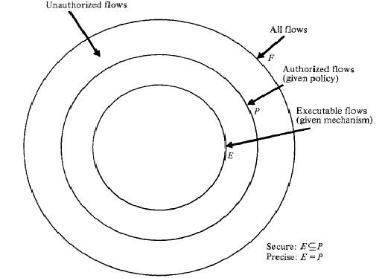
Security and Precision
F be the set of all possible flows in an information flow system,
P be the subset of F authorized by a given flow policy,
E be the subset of F "executable“ given the flow control mechanisms in operation.
The system is secure if E P;
that is, all executable flows are authorized.
A secure system is precise if E = P;
that is, all authorized flows are executable.

Slide 18
Enforcements
Example
Y:= k* x
Policy: k ≤ y but x !≤ y
A mechanism that always prohibits execution of this statement will provide security.
k = 0 or H(x) =0
To design a mechanism that verifies x ≤ y the relation only for actual flows x → y is considerably more difficult than designing one that verifies the relation x ≤ y for any operation that can potentially cause a flow x → y

Slide 19
Un-decidability
Showing whether a system is secure or precise
if f(n) halts then y := x else y := 0
where f is an arbitrary function and x !≤ y
it is theoretically impossible to construct a mechanism that is both secure and precise

Slide 20
Example
y:=x;
z:=y;
y:=0
y must satisfy x ≤ y to reflect the flow x → y
After the last statement is executed y can be lower than x as y no longer contains info. about x
Thus, the security class of an object can be increased or decreased at any time as long it does not violate security.

Slide 21
Channels of Flow
Legitimate Channels: intended for information transfer between processes or programs
e.g., the parameters of a procedure.
Storage Channels: Objects shared by more than one process or program
e.g., a shared file or global variable.
Covert Channels: which are not intended for information transfer at all
e.g., a process's effect on the system load.
Example:
Process p can transfer a value x to a process q through the lock bit of a shared file f
p arranges regular intervals of use and nonuse of x according to the binary representation of x;
q requests use of the file each interval, and determines the corresponding bit of x according to whether the request is granted.

Slide 22
Dynamically Enforcing Security for Flows
Explicit Flows
Implicit Flows
Occurs due to assignment
Y := y (x1, … , xn)
xi → y can be verified by
x1 …. xn ≤ y
If not an error can be generated (skipped/aborted)
Verifying implicit flows to an object only at the time of an explicit assignment to the object is insecure.
Verifying the requirement when doing y:= 1 in “ if x=1 then y:=1 fi” would be insecure!
What is to be done?

Slide 23
Handling Implicit Flows (Execution Based Mechanisms)
Security can be enforced by verifying flows to an object only at the time of explicit assignments to the object.
Except that:
attempted security violations cannot generally be reported.
I.e., if an unauthorized implicit flow is detected at the time of an assignment, not only must that assignment be skipped, but the error must not be reported to the user,
and the program must keep running as though nothing has happened.
The program cannot abort or even generate an error message to the user unless the user's clearance is at least that of the information causing the flow violation. I
It would otherwise be possible to use the error message or abnormal termination to leak high security data to a user with a low security clearance.
Note that the program must terminate in a low security state;
that is, any information encoded in the program counter from tests must belong to the class Low.

Slide 24
Example
Example:
Secure execution of the if statement
if x = 1 then y := 1
is described by
if x= 1
then if x ≤ y then
y := 1 else skip
else skip .
Suppose x is 0 or 1, y is initially O,
x = High, and y= Low;
thus, the flow x → y is not secure.
Because the assignment to y is skipped both when x = 1 (because the security check fails) and when x = 0 (because the test "x = 1“ fails), y is always 0 when the statement terminates, thereby giving no information about x.
Note that if an error flag E is set to 1 when the security check fails, then the value of x is encoded in the flag (E = 1 implies x = 1, E = 0 implies x =0).

Slide 25
Conditional Assignment
Y := f(x1,…,xm)
Conditioned on
x(m+1)… xn
Then the explicit and implicit flow to y can be validated by checking that the relation
Secure because y is not changed;
Thus no implicit flow
1.Simpler to construct a run-time enforcement mechanism if all implicit
and explicit flows can be validated only at the time of actual assignments.
2. Such a mechanism is likely to be more precise than one that checks implicit
flows that occur in the absence of explicit assignments.

Slide 26
Example
If x=1 then y:=1 else z:=1 --- x is High
x=1 , y = high and z = Low
x ≠1 , y = low and z = high
What happens if you test
x ≤ y and x ≤ z

Slide 27
Error Flagging (1)
An error flag can be securely logged in a record having a security class at least that of the information.
Although it is insecure to report it to a user in a lower class, the capacity of the leakage channel is at most 1 bit (because at most 1 bit can be encoded in a 1-bit flag).
The error message can, however, potentially disclose the exact values of all variables in the system.
Suppose information in the system is encoded in variables x1, ... xn, y is zero and xi !≤ y
Then
If (x1 = val1) & … & (xn=valn)
then y :=1
Generates an error message when
(x1 = val1) & … & (xn=valn)
Then all values are known due to error message. Assume that only one xi != vali then little can be deduced from y

Slide 28
Error Flagging (2)
If not [ (x1 = val1) & … & (xn=valn)]
then y :=1
terminates successfully without causing security error when x1 = val1 . . . x n= valn, leaking the exact values of x1 . . . x n.
Note, however, that the values of x1, . . . , x n are not encoded in y, because y will be 0 even when the test succeeds.
The values are encoded in the termination status of the program, which is why only 1 bit of information can be leaked.

Slide 29
Error Flags (3)
It is clearly unsatisfactory not to report errors, but errors can be logged, and offending programs removed from the system.
This solution may be satisfactory in most cases.
It is not satisfactory, however, if the 1 bit of information is sufficiently valuable (e.g., a signal to attack).

Slide 30
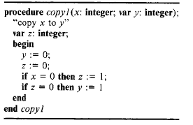
Consider the execution of the procedure copy1.
Suppose the local variable z has a variable class (initially Low), z is changed whenever z is assigned a value, and flows into y are verified whenever y is assigned a value.
Procedure -- executed with x = 0, the
test "x = 0“ succeeds and
(z, z) becomes (1, x); hence the test "z = 0" fails, and y remains 0.
If it is executed with x = 1, the test
"x = 0" fails, so (z, z) remains (0, Low); hence the test "z = 0" succeeds, y is assigned the value 1, and the relation Low ≤ y is verified.
In either case, execution terminates with
y = x, but without verifying the relation x ≤ y

